Slide 1
The United States in World War II

Slide 2
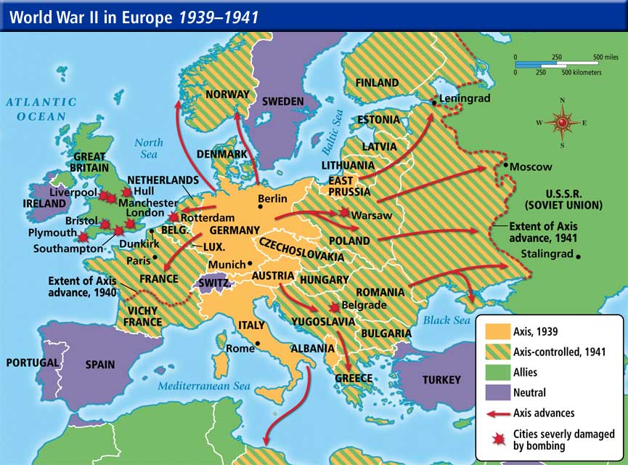

Slide 3
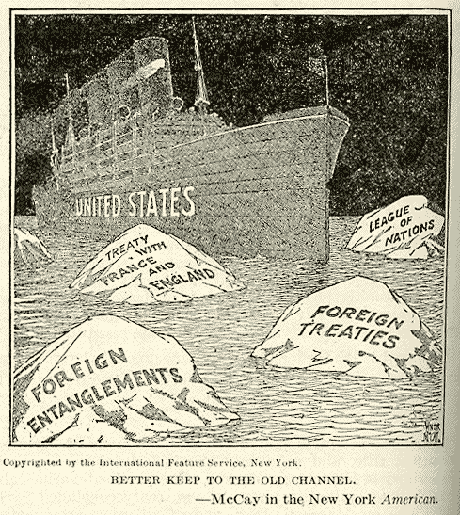
American Isolationism
Following WWI, Americans began to overwhelmingly support isolationism, or avoiding involvement in international disputes
This isolationist ideal was the driving force behind the US not joining the League of Nations.
Remember the Kellogg-Brand Pact 1928 too.

Slide 4
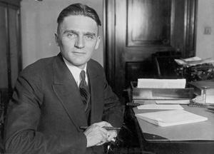
The Nye Committee
Congress created a special committee in 1934 to investigate the role that weapons manufacturers had in involving the US in WWI
The Nye Committee’s report implied that certain businesses had profited from the war, leading many American’s to believe that they had been tricked into entering WWI
Again, this encouraged American support of isolationism

Slide 5
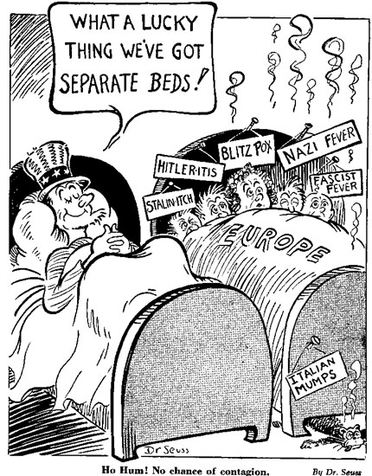
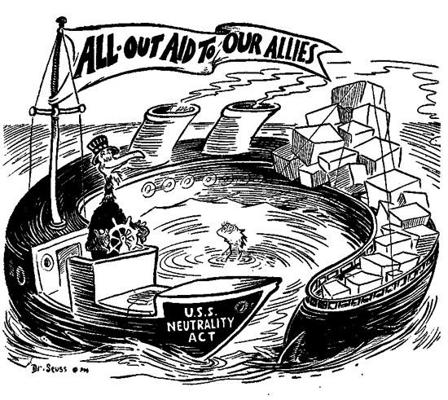
America Enters World War II
Year | Event in the U.S. | → | Impact
1935 1937 1939 | Congress passes the Neutrality Acts. | → | What did the Neutrality Act allow? In 1935, Congress passed the first Neutrality Act, making it illegal for the US to sell weapons to any nation at war In 1937, Congress expanded the Neutrality Act to require any non-military supplies sold to nations at war to be paid for in cash and transported on their own ships In 1939, after WWII had started, the Act was amended to allow arms sales to Britain, but still under “cash & carry” terms

Slide 6
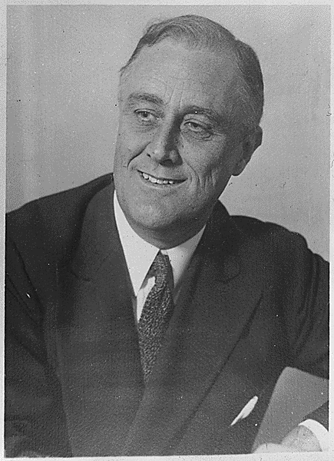
Roosevelt’s Internationalism
FDR wasn’t an isolationist
He supported the idea that trade between nations increases prosperity for all and decreases the chances of war, an idea not supported by the American public
For political reasons, FDR had to be careful not to push Americans too hard on getting involved in foreign affairs

Slide 7
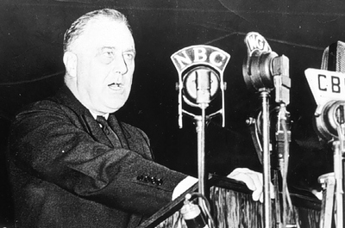
The Quarantine Speech
October 1937
FDR called for a “quarantine” (political and economic sanctions) against any “aggressor” nations who disregard international law or attack their neighbors unprovoked
The speech angered many American isolationists because it called for US involvement in the foreign affairs of others

Slide 8
Isolationism Debate
The Destroyers for Bases Deal opened a new debate over what role, if any, America should have in the war
Some people wanted the US to take an active role in the war (Ex. Fight for Freedom Committee)
Some wanted the US to increase aid to the Allies but not get involved in the fighting (Ex. Committee to Defend America by Aiding the Allies)
Some opposed ANY involvement in the war (Ex. America First Committee)

Slide 9
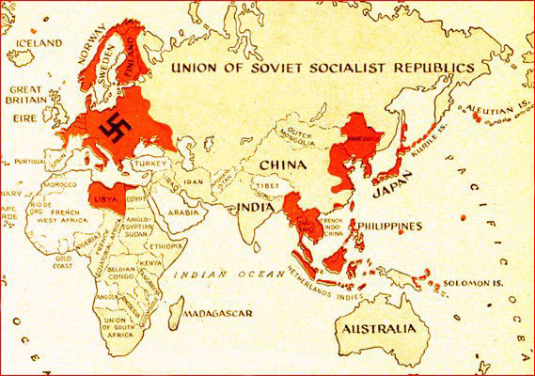
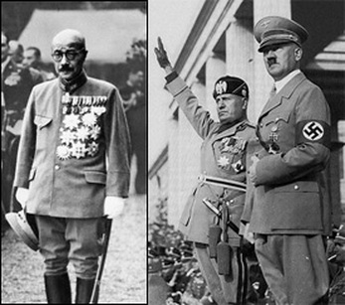
America Enters World War II
Year | Event in the U.S. | → | Impact
1940 | Axis powers form alliance. | → | Who were the Axis powers? What did their alliance mean for the United States? Japan, Germany and Italy If the U.S. declared war on any of the Axis powers, it would have to fight a two-front war

Slide 10
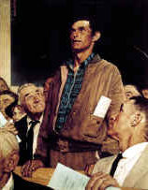
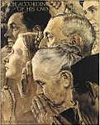
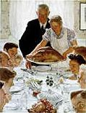
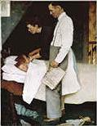
FDR’s “Four Freedoms” Speech
January 1941
Roosevelt argued that the US & Britain were natural allies because they both stood for:
Freedom of speech
Freedom of worship
Freedom from want
Freedom from fear

Slide 11
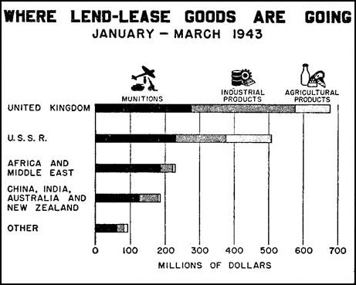
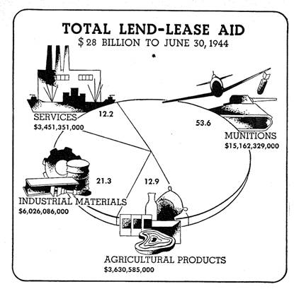
America Enters World War II
Year | Event in the U.S. | → | Impact
March-1941 | Congress passes the Lend-Lease Act. | → | What did the Lend-Lease Act do? US declared that it would lend or lease weapons (since it couldn’t sell them due to the Neutrality Acts) to nations considered “vital to the defense of the US” US went on to send $40 billion in weapons to the Allies over the course of WWII

Slide 12
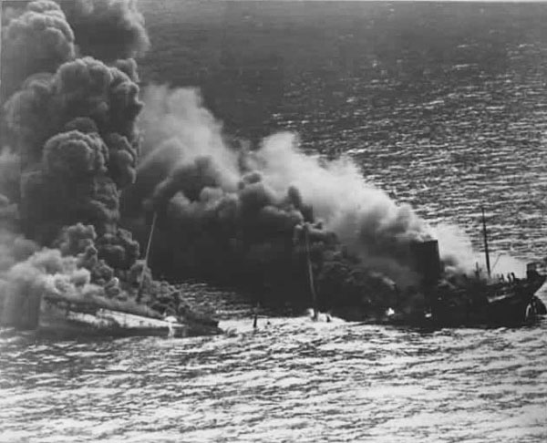
Hemispheric Defense Zone
To help protect British shipping, FDR declared the entire Western Atlantic to be part of the Western Hemisphere and thereby under the protection of the US per the Monroe Doctrine
FDR then ordered the US Navy to patrol this part of the Atlantic, leading to several deadly encounters between US destroyers and German U-boats

Slide 13
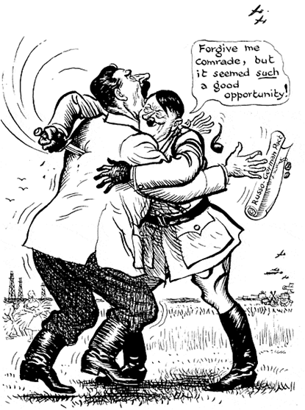
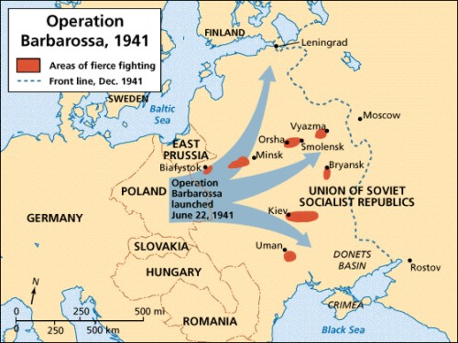
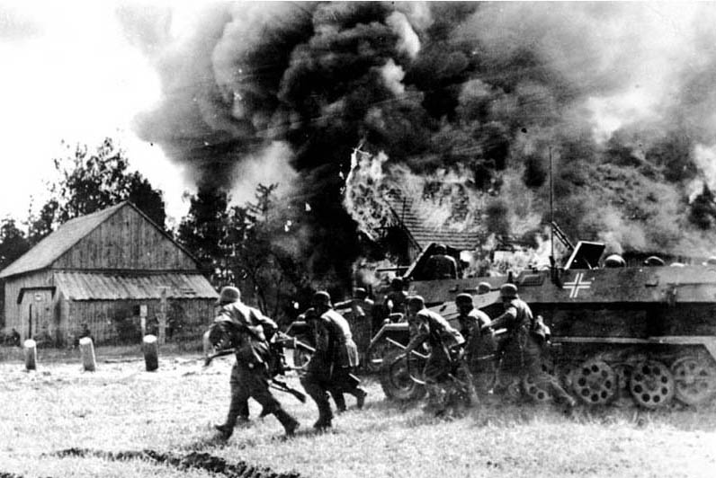
Year | Event in the U.S. | → | Impact
1941 | Germany invades USSR. | → | Operation Barbarossa… Soviet forces resorted to a “scorched earth” campaign, burning everything of use to the Germans as they retreated across the Ukraine Finally, the harsh Russian winter stalled the Germans, buying the Soviets time to regroup and stop the German advances Sep 1941-Jan 1944- ( Seige of Leningrad) Hitler was obsessed with capturing the Soviet city of Leningrad due both to its symbolical importance as the “City of Lenin” (Lenin had led the Bolshevik Revolution) and its military importance as a naval port on the North Sea 1.5 million Soviets died during the siege, mostly from starvation and disease; the population resorted to eating sawdust, boiled leather, rats, pets, horses, and, eventually, each other!

Slide 14
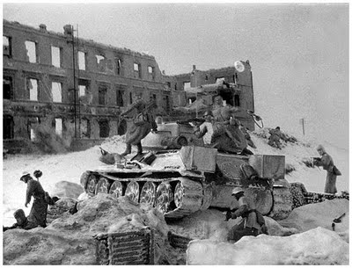
Battle of Stalingrad
July 1942 – February 1943
Bloodiest battle in history
1.5 million killed
Vicious urban warfare as the Germans and Soviets fought street by street, building by building for control of the city
Soviets eventually encircled the German army, which was forced to surrender en masse
500,000 Germans captured, but few of them survived being imprisoned in the brutal Soviet gulags (prison camps)

Slide 15
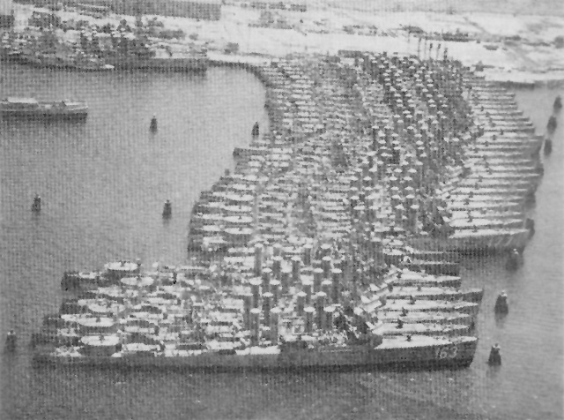
Destroyers for Bases Deal
Spring 1940: FDR agreed to trade 50 surplus US Navy destroyers to Britain (who needed them to protect shipping) in exchange for allowing the US to build naval bases in British-controlled territories

Slide 16
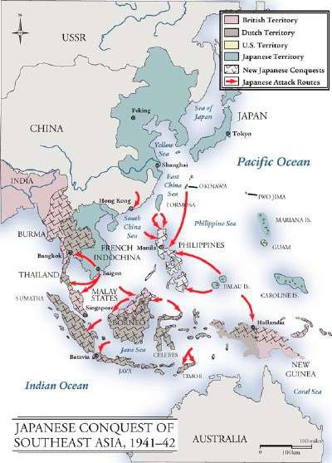
Year | Event in the U.S. | → | Impact
1941 | Japan takes over French military bases in Indochina. | → | What did the United States do to protest Japan’s action? Punished Japan with a trade embargo (particularly oil which threatened Japan’s expansion) to put pressure on Japan to make peace with China and Britain. Japan considered this an act of war and began to plan an attack on US military facilities in Hawaii and the Philippines

Slide 17
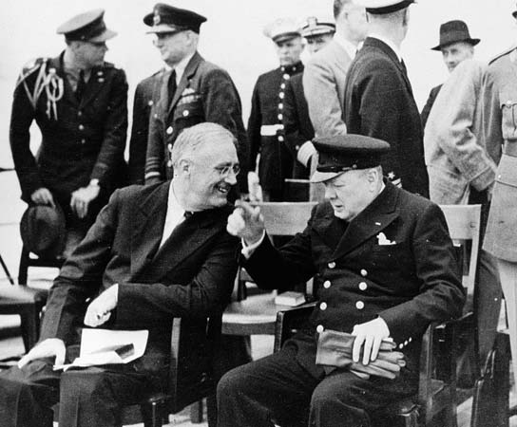
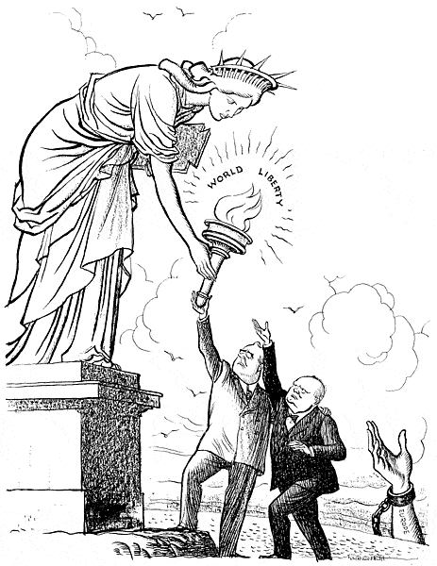
Year | Event in the U.S. | → | Impact
1941 | Congress extends the draft. | → | FDR met with British Prime Minister Winston Churchill to lay out a post-war plan for economic prosperity. What pledges were contained in the Atlantic Charter? Collective security, disarmament, self-determination, economic cooperation, freedom of the Jews Many question whether or not this is where FDR promised Churchill that he would find a way to get the American people to support the US entering the war
 | Churchill and Roosevelt draft the Atlantic Charter.
Liberty
Europe
U.S. & Great Britain

Slide 18
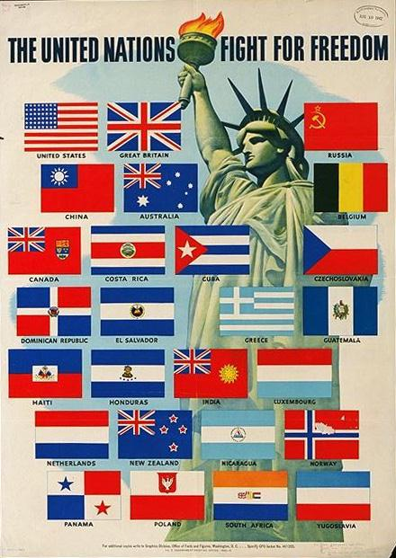
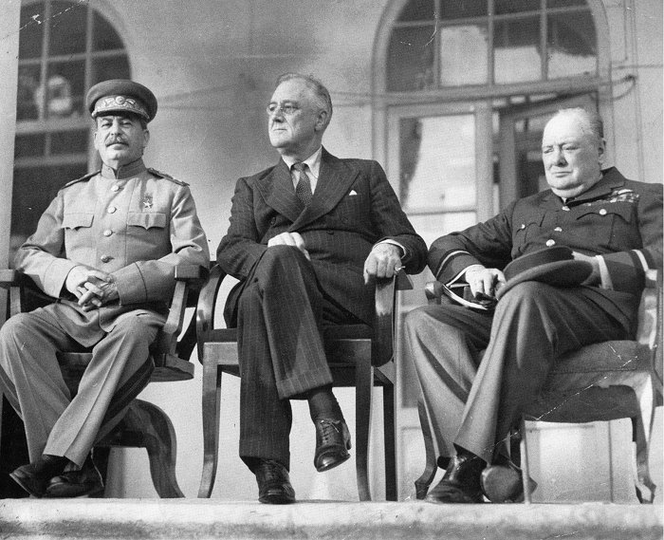
America Enters World War II
Year | Event in the U.S. | → | Impact
1941 | “A Declaration by the United Nations” is signed by the Allies. | → | Who were the Allies? An alliance of 26 nations that had joined together to fight the Axis powers (U.S., Great Britain, France, and Soviet Union led)

Slide 19
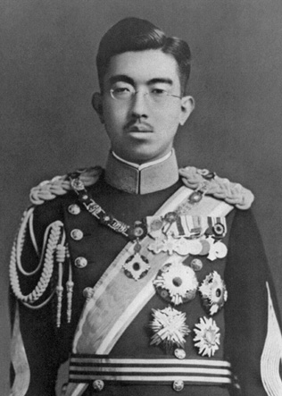
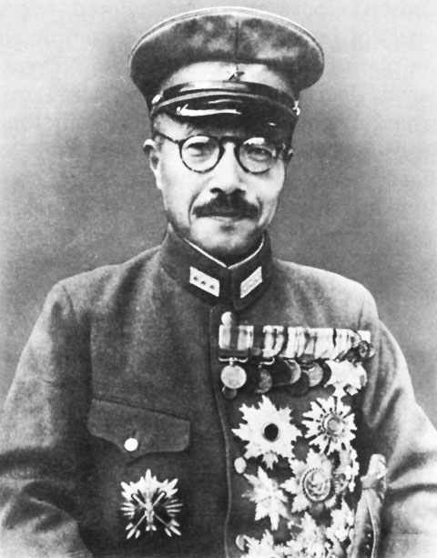
America Enters World War II
Year | Event in the U.S. | → | Impact
1941 | Hideki Tojo becomes Japan’s prime minister. | → | Emperor Hirohito was only the formal leader of Japan; Tojo held the real power

Slide 20
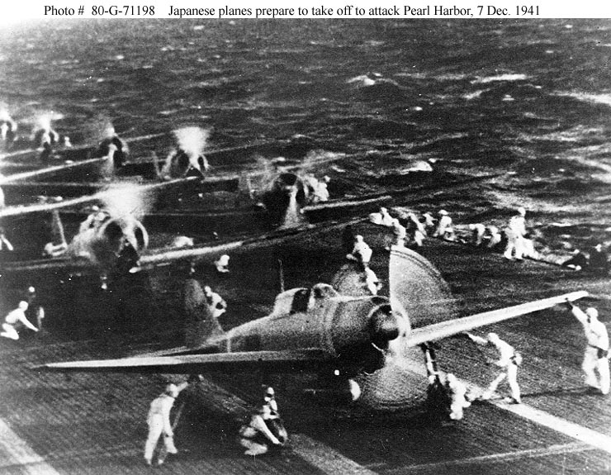
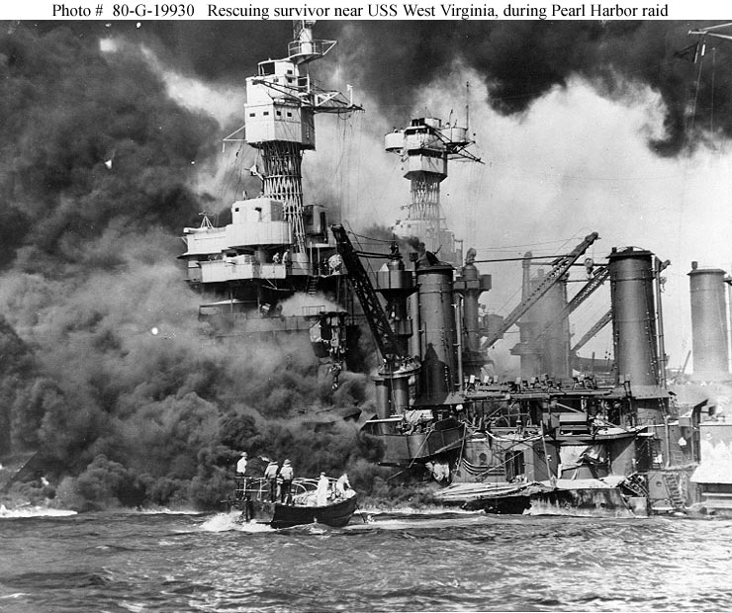
Year | Event in the U.S. | → | Impact
12/7/1941 | U.S. Senate allows arming of merchant ships. | → | 4 battleships destroyed, 4 more seriously damaged, but Japan failed to destroy US aircraft carriers Support vessels and facilities suffered massive damage 2403 Americans killed, 1178 wounded Japanese lost only 29 aircraft and 65 men What did the attack do to the Pacific fleet?
 | Japan launches surprise attack on Pearl Harbor.

Slide 21
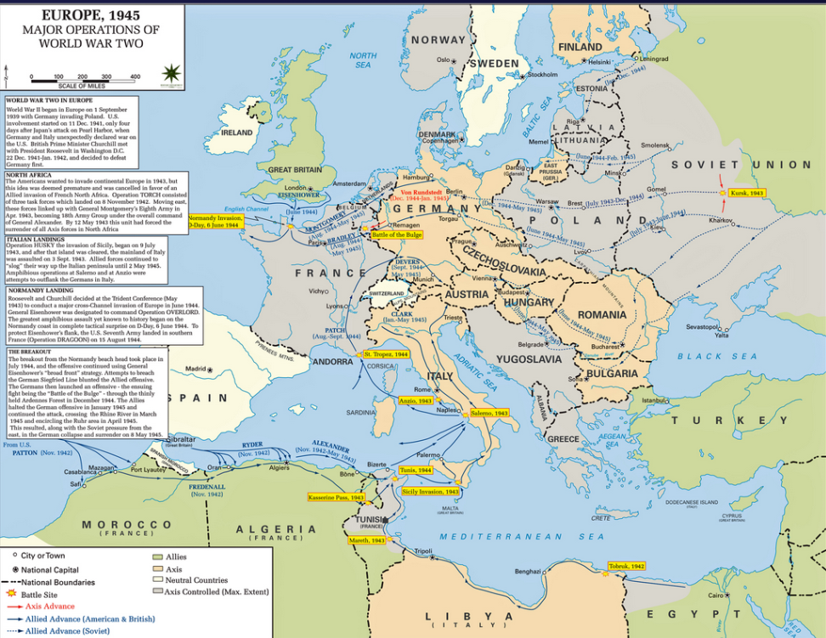
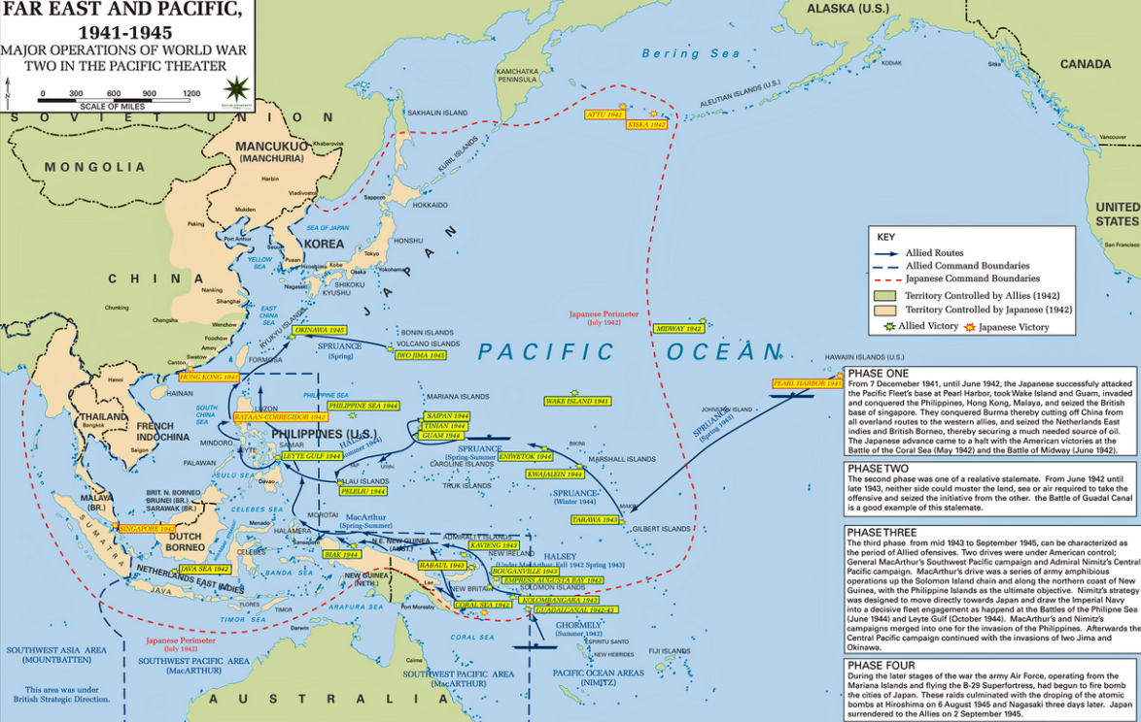
America Enters World War II
Year | Event in the U.S. | → | Impact
12/8/1941 | As U.S. declares war on Japan, Germany and Italy declare war on U.S. | → | Why did Germany and Italy declare war on the United States? They had signed a mutual defense treaty with Japan in which they agreed to come to each other’s aid in the event of attack.

